Slide 1
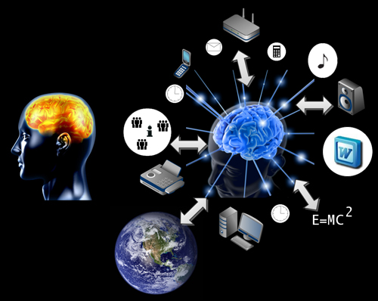
Distributed Cognition

Slide 2
Distributed Cognition
Main reference: Hutchin’s paper on Distributed Cognition (in the wild), see GitHub
For a brief summary see: http://en.wikipedia.org/wiki/Distributed_cognition
http://etec.ctlt.ubc.ca/510wiki/Distributed_Cognition

Slide 3
Distributed Cognition Theory
Seeks to describe the organization of cognitive systems
Unit of analysis is not the individual but the socio technical system
Considers a broader class of cognitive events (not just within a head)
e.g. memory involves manipulation of objects and external representations
Notes:
Cognitive is not bounded to the individual’s brain
e.g. airline cockpit

Slide 4
Cognition in the wild
Cognitive processes may be distributed across members of a social group
Cognitive processes may involve coordination between internal and external (material or environmental) structure
Process may be distributed through time – with products of earlier events transforming nature of later events
Notes:
To design good systems, we have to understand the nature of these distributions of process.

Slide 5
Social organization as a form of cognitive architecture
How are the cognitive processes of an individual distributed across a group of individuals?
How are the cognitive properties of individual minds affected by participation in group activities?
Notes:
Cognitive processes involve trajectories of information (transmission and transformation) – patterns if stable reflect an architecture

Slide 6
Embodied Cognition
Minds are not passive representational engines..
Organization of the mind is an emergent property of interaction among internal and external resources
Notes:
Well designed work materials become integrated into the way people think, see and control activities

Slide 7
Culture and cognition
Culture shapes cognitive processes that are distributed over agents, artifacts and environments
The environment as a reservoir of resources for learning, problem solving and reasoning…
Culture provides us with intellectual tools, but culture may also blind us…
Notes:
Example? Assuming there is only one way to do something because we always did.

Slide 8
How to study distributed cognition?
Ethnography – not just of minds but also of artifacts and social processes – event centered, to develop a theory
Requires domain expertise and knowledge of the structure to study events
Followed by experiments (to refine the theory)
Back to more studies “in the wild”
Notes:
Cognitive ethnography is not a single technique… will come back to this later when we discuss research methods (in 2 weeks)

Slide 9
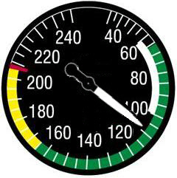
Principles of distributed cognition theory
People establish and coordinate different types of structure in their environment
It takes effort to maintain coordination
People off-load cognitive effort to the environment whenever practical
There are improved dynamics of cognitive load-balancing available in social organization
Studies reveal uses of representations that were not anticipated
Notes:
e.g. airspeed instrument
Weather radar graph – refueling
Todo’s in source code comments.

Slide 10
Some points for discussion
What unexpected ways do you offload cognition to artifacts (e.g. pilots use of weather radar to remind about refueling)?
Can you think of digital artifacts you have used that provide information about their history of use? (e.g. in email)
What strategies do you use with digital representations of real objects to help you organize our work?
How has the cloud enhanced our distributed cognition processes?
Notes:
History enriched digital objects (how could this be used in course materials?)
code, links.
Read wear not just edit wear.
Menus
Popular news.
Any issues with this? (privacy, self fulfilling)
Spatial arrangements can simplify choice (piles), simplify perception (e.g. XXX) or simplify internal computation (sorting).

